Slide 1
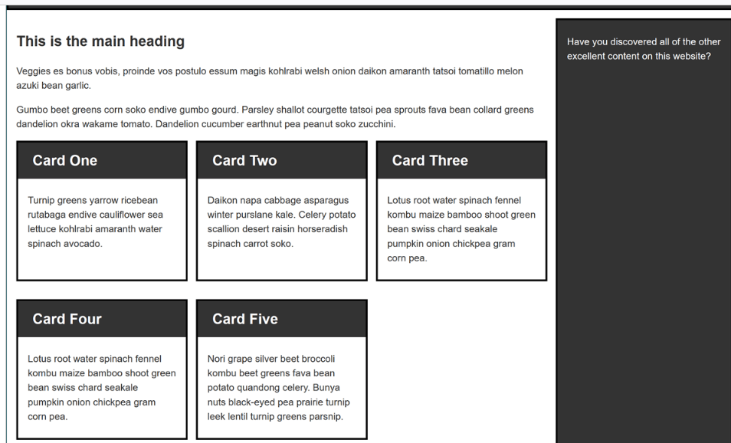

Slide 2
Design Templates by using HTML & CSS
Design a template for a trendy coffee shop. Include sections for the menu, online reservations, and a gallery of the establishment. Prioritize a visually appealing design that complements the restaurant's brand.
Develop a real estate website template for showcasing property listings. Include features like property details, images, and a search functionality. Prioritize a clean and organized layout for property information.

Slide 3
Create a template for an online learning platform. Include sections for courses, instructors, and student testimonials. Prioritize user-friendly navigation and an intuitive course discovery process.
Design a personal portfolio template for a front-end developer. Include sections for About Me, Projects, Skills, and Contact. Emphasize a clean and modern design with a focus on showcasing coding projects.

Slide 4
A local restaurant needs a website redesign to attract more online orders. Discuss how you would enhance the restaurant's website, including menu presentation, online reservation system, and any other features to improve the overall user experience.

